Slide 1



TOPIC: Introduction to Web Design
COURSE : Short Term Course Certificate Course in Web Designing
Presentation By : Manish Kumar

Slide 2
Topics to be Covered
Introduction to Internet, History
WWW, Browser, HTTP
Webpage, URL, Website
Working of website
Types of website, Search Engine
Front End and Back End, Scripting Language
Responsive Web Design

Slide 3
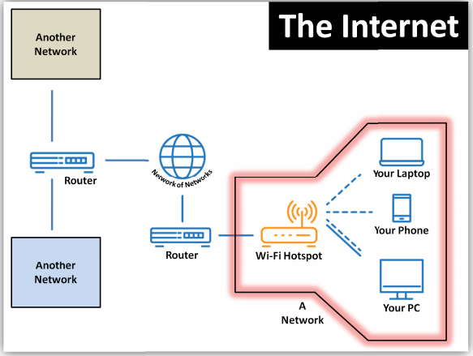
Introduction to Internet
The Internet is a globally connected network system that uses TCP/IP (Transmission Control Protocol/ Internet Protocol) model to transmit data via various types of media (wired or wireless).
It is a network of networks (Inter - Networking).
It is network of global exchanges including private, public, business, academic, government etc. networks connected together.
Millions of millions people are users of Internet.
It has complex combination of several technologies and services used around the world every day.

Slide 4
History of Internet
The Advanced Research Project Agency (ARPA) in the Department of Defense (DoD) of US government was initially desired to connect its computers so that researchers could share the resources.
In 1967, ARPA presented its idea for ARPANET, a small network of computers. The idea was in short that each host computer would be attached to a specialized computer called IMP (Interface Message Processor) to create network.
By 1969, ARPANET connected four nodes - the University of California Los Angeles (UCLA), the University of California at Santa Barbara (UCSB), Stanford Research Institute (SRI) and the University of UTAH via IMPs to form a network.
Then, a team of defence engineers at the University of California at Los Angeles (UCLA) sent the first every instant message successfully via computer to another team thousands of miles away at Stanford.

Slide 5
History of Internet (contd.)
The technology continued to grow. In the 1970, after scientist Robert Kahn and Vinton Cerf developed TCP/IP, a communication model that set standard for how data could be transmitted between multiple networks.
ARPANET adopted TCP/IP on Jan 1st, 1983 and from there researchers began assemble the networks of network that became modern Internet gradually.
The online world then took on a more recognizable form in 1990 when computer scientist Tim Berners Lee invented WWW (World Wide Web).WWW popularized the Internet among public.

Slide 6
WWW (World Wide Web)
World Wide Web (WWW) is sometime referred to only as “Web”.
The idea of WWW was proposed by Tim Berners Lee in 1989 and the commercial web started in 1990.
It is one of the service of Internet and used for accessing data online in the form of websites and hyperlinks.
It is repository of information in which the documents are distributed all over the world and related document are linked together.
The service provided is distributed over many location called websites or sites.
Each site holds many web pages and web pages can contain links to other related web pages.
It works on distributed client server service, in which client using browser can access a service from server.

Slide 7
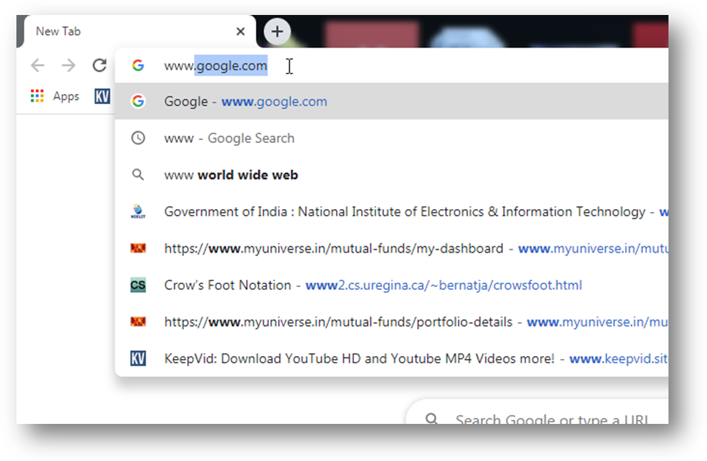

Slide 8
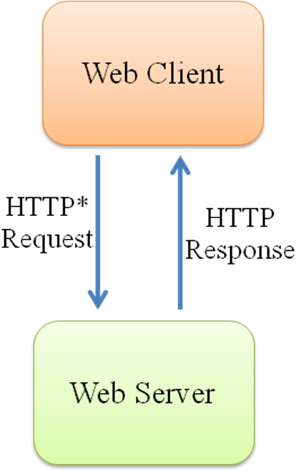
Web Server
Web Client
Web browser is known as web client that interpreted display web pages. A variety of commercial and free web browsers are available in the market like MS Internet Explorer, MS Edge, Google Chrome, Mozilla Firefox Opera, Safari Netscape Navigator Mosaic etc.
Web Server
Web server is a computer where web pages are stored. It is used to host the websites. Web server contains software that respond to the request for web resources made by web clients.
*Hypertext Transfer Protocol (HTTP). It defines the rules how the communication takes place between web client and web browser.

Slide 9
HTTP (Hyper Text Transfer Protocol)
HTTP transfer files such as text, graphics, images, sound, video and other multimedia files on WWW.
It defines rules how the client server program can communicates retrieve web pages from WWW.
A HTTP client sends request and HTTP server return response.
HTTP uses 80 number port by default.
It is connection oriented and reliable protocol, and uses the services of TCP (Transmission Control Protocol).
It is stateless protocol which means client and server does not retain any information between various request/response of the web page. They know each other only the current request/response.

Slide 10
HTTP Secure
HTTP Secure (HTTPS) is an extension of HTTP. It is used for secure communication over WWW.
It uses 443 port number by default.
It establishes an encrypted link between the browser and web server.
HTTPS is encrypted using TLS (Transport Layer Security) or SSL (Secure Socket Layer).

Slide 11
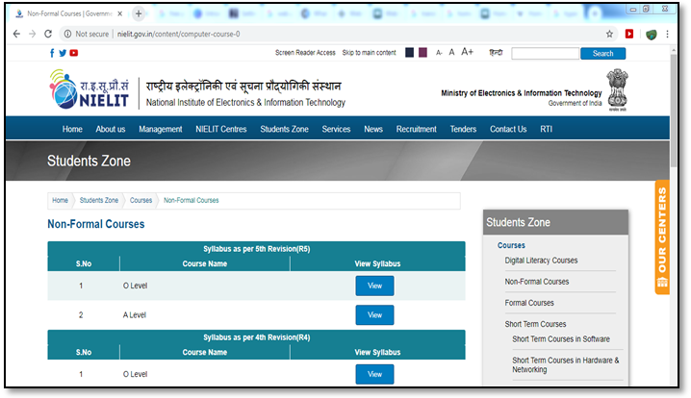
Webpage
A web page is single document or page available on world wide web.
The web pages are created using HTML (Hyper Text Mark-up Language) and are interpreted, displayed by
web browsers.
Each web page has unique address called URL (Uniform Resource Locator) which distinguishes one page to
another on WWW. For example, the URL of a web page of NIELIT like:
http://nielit.gov.in/content/computer-course-0
Figure: A Webpage

Slide 12
URL (Uniform Resource Locator)
A URL is the address of a specific webpage or file on the internet.
It distinguishes one web page to another.
It is unique identifier for a webpage or file on the internet.
The URL has following parts:
Protocol – Usually it is http, but it can ftp, https, mailto etc.
Host – It is the IP address or domain name of the server.
Port – It is 16 bit integer. 80 for http protocol. If a different port is used then the number can be written explicitly.
Path – The location and name of the file/web page.
It looks like:
protocol://host/path
protocol://host:port/path

Slide 13
Website
A website is a collection of related web pages.
It may contain text and other multimedia elements like images, graphics, videos etc.
The website loads with its default web page called Home page of the website.
The related web pages are linked together using concept of hyper linking and hyper text.
A hyperlink is link or reference that points to another webpage or another location of same web
page.
A Hypertext is that text on webpage that contains hyperlink. When user move mouse over the
hypertext, the shape of the mouse gets changed, and by clicking on hypertext, the user can move
another location.
Actually the term hypertext has been now replaced with hypermedia because not only text but also
images,video etc can be hyperlinked in the webpage.
A website can be accessed by typing website’s name (known as domain name) in the address bar
to the web browser (like Google chrome, Mozilla firefox etc).
Examples of some websites are www.nielit.gov.in (NIELIT’s Website), www.facebook.com
(Social networking site), www.google.com (search engine site).

Slide 14
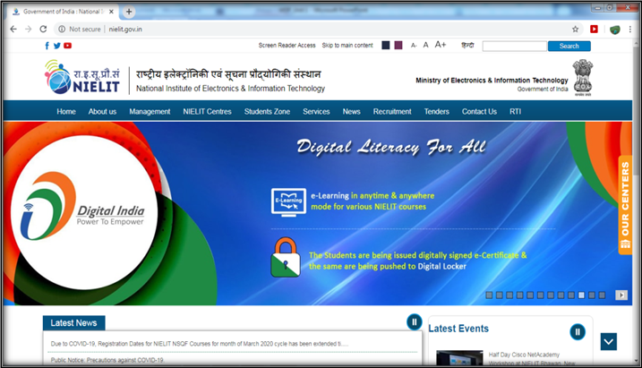
Figure: Home page of NIELIT’s website

Slide 15
Working of website
The working of website can be understood in following steps:
Step 1: Firstly user makes request for accessing a website by typing its domain name (saywww.nielit.gov.in) in the address bar of the browser.
Step 2: The browser sends request to DNS (Domain Name System) server for looking IP address of the domain name.
Step 3: The DNS translates the human readable domain name into numeric IP address (say 164.100.129.96).
Step 4: The DNS server returns the IP address to the browser.
Step 5: The browser now sends the request for web page using IP address provided by DNS to connect to the web server.
Step 6: The web server responds the request made by web client (browser), and returns the copy of web page (static or dynamic) based on the request.
Step 7: The web page is now displayed on the web browser.

Slide 16
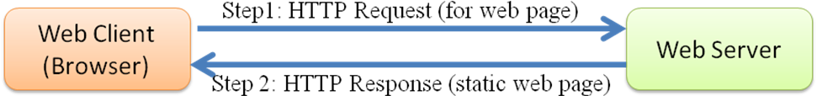
Types of website
There are two types of websites:
Static Websites
Dynamic Websites
Static Websites:
Static websites, as its name suggests, are those which has predefined and fixed contents and remain same every time when user accesses the website. Static websites are informative website.
The user can not interact with static website. Static websites do not require any information to be stored in the database.
Static websites are designed using only front end tools (HTML, CSS, and JavaScript).
The contents of static websites can be changed manually at server side. The user can not modify it.
Figure: Working of Static website

Slide 17
Dynamic Websites:
Dynamic websites are created using front end and back end tools. Dynamic website is something whose contents changes dynamically on the basis of user request.
The examples of dynamic website include facebook, twitter etc.
The contents of these website changes as per the user input. The contents of the facebook’s website like posts, comments, photos etc are stored in the database. The facebook page differs from one user to another user.
In dynamic website, when user makes request for web page, it is processed at server side and dynamically the web page is created in real time, then transferred to client side and displayed on the browser.

Slide 18
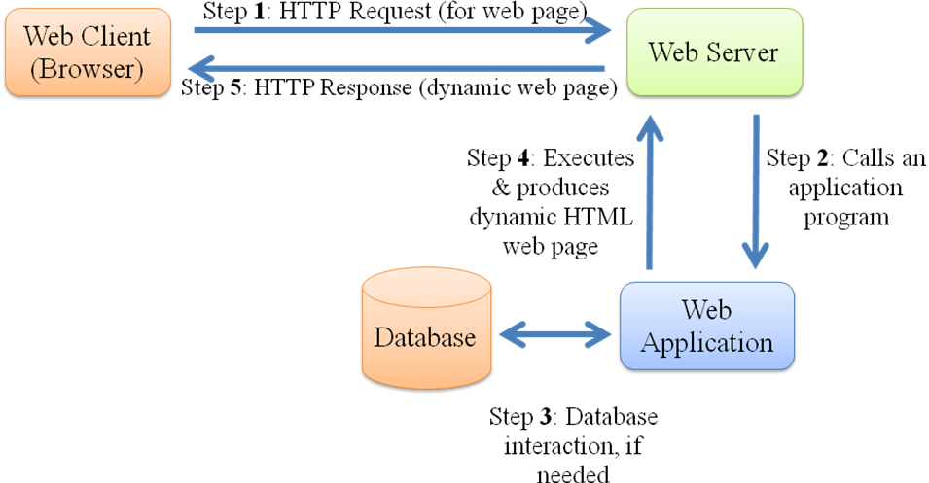
Figure: Working of Dynamic website

Slide 19
Search Engine
Search engine a software program that allows Internet users to search the contents on the web (WWW).
A user enters keyword into search engine and receives a list of web contents results in the form of websites, images, videos and other online data.
The list of contents searched via search engine to a user is known as SERP (Search Engine Results Page).
One of the most powerful and famous search engine on the web is GOOGLE. It searches the most relevant, accurate and valuable information.
Other web search engines include: Yahoo, Bing, Baidu, AOL, Ask.com, DuckDuckGo, Lycos, Internet Archive, Yandex etc.
The working of Search Engine includes:
Crawling
Indexing
Ranking & Retrieval

Slide 20
Crawling: Crawling is the process of scanning of billions of web pages and obtaining information about everything that is contained on the web page by URL/page title/ heading/Meta data etc. Web crawlers are also called search engine ‘bots’ or ‘spiders’.
Indexing: WebPages that have been found by crawler are then added into a data structure called Index. The index includes all the discovered URLs along with key signal about the content of each URL like keyword, the type of content etc.
Ranking & Retrieval: Whenever online search is performed, search engine looks its database for most relevant results based on the popularity of the website. Relevance and popularity are the most important factor to provide satisfactory result.
A searching algorithm is used to rank the relevant pages into set of results. Search engine also uses other relevant data to return results like location language, previous search history etc.

Slide 21
Front End
Front end refers to client side design of website. Front end is involved with what the users see and interact with the website i.e. the User Interface (UI) which includes the design, layout, navigation menu, text, images, videos, image gallery etc.
The languages used for front end designing and development of the website include
HTML – It is fundamental language for creating and organizing web contents.
CSS – It defines the style and layout of the website contents.
JavaScript – It is used for more interactive elements, handling events and to set the behavior of the webpage.

Slide 22
Front End Frameworks
Apart from above, here are some most popular front end framework and libraries:
React.JS , Next.JS
JQuery (Library of JavaScript) - It simplifies the programming of JavaScript.
Angular JS (Library of JavaScript) - It is used for developing mobile and desktop applications.
W3.CSS (CSS Framework) - It is used for creating responsive website. It contains standard CSS only.
Bootstrap (CSS and JavaScript Framework) - It is also used for creating responsive website. It contains CSS and JavaScript.

Slide 23
Back End
Back end refers design and development of website at server side.
It is involved with what the user cannot see in the browser like database and server information etc.
It concerns with security aspects, data storage and manipulation, content management, user authentication etc.
The languages used for back end development of the website include:
Python, PHP, Java, Ruby etc.
Popular framework for back end: Express, Django, Node.js, MongoDB etc

Slide 24
Scripting Language
Script or Scripting language is a programming language with a series of commands, which is executed without being compiled.
It is often interpreted and automates the execution of tasks.
It is of following two types:
Server side scripting language
Client side scripting language
Server side scripting languages are those that are executed on web server. User cannot see the processing of scripts. It deals with database, provide customize and dynamic content to the web page based on the user request. The examples include Perl, PHP, ASP and Python etc.

Slide 25
Client side scripting languages are those that are executed on client side without server side processing of codes. It requires browsers to run the scripts. It can be used to validate user data before submitting to the server. It minimizes the loads of the server. The examples include: HTML, CSS, and JavaScript.
The client side scripting languages deals with front end of the website where as server side scripting languages deal with the back end of the website.
The client side scripting languages are used to design and develop static website where as server side scripting languages are used for designing of dynamic website.

Slide 26
Responsive Web Design
Responsive Web Design (RWD) means designing of website in such a way that the contents of websites automatically fit and resize that makes the website looks good on all devices (PC, laptop, tablets or mobile phones) wherever it is opened.
Now a days, users view the website using different devices (PC, laptop, tablets or mobile phones) and the screen size of the devices differs from one another, therefore the designing of the website must be in such a way that it looks good in all the devices.
HTML and CSS (Cascading Style Sheet) technologies are used together to make the website responsive.
We can understand it by following figure which depicted how the contents of the website fits arrange and resize on various screen size:

Slide 27
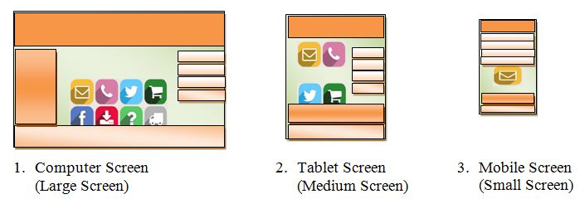

Slide 28
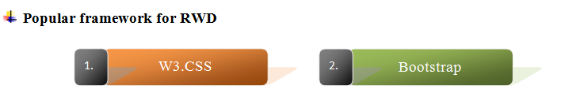
W3.CSS
W3.CSS is a free and modern CSS framework published by W3school for developing responsive, mobile-first websites.
It is smaller and faster than similar CSS frameworks.
It is easier to learn and use.
It simply and speed up the development of website
W3.CSS is inspired from Google Material Design.
It includes only standard CSS.
No jQuery or JavaScript library included in it.

Slide 29
Bootstrap
Bootstrap is a web framework that simplifies the development of informative web pages.
It is one of the most popular HTML, CSS, and JavaScript frameworks for developing responsive, mobile-first websites.
It is open source toolkit having powerful library of typography, forms, navigation bar, image gallery, buttons, carousel etc.
Bootstrap, originally named Twitter Blueprint, was developed by Mark Otto and Jacob Thornton at Twitter as a framework. After a few months, it was renamed from Twitter Blueprint to Bootstrap, and released as an open source project on 19th August, 2011.

Slide 30
Self-assessment for Day-01
What is full form of HTTP?
Hyper Text Transmission Protocol
Hyper Text Transfer Program
Hyper Text Transfer Protocol
Hyper Text Transfer Path
In URL, ___________is client server program used to retrieve the document?
Protocol
Path
Host
Domain

Slide 31
_______ is a language for creating web pages.
HTTP
HTML
FTP
DNS
The WWW is a _______ client server service, in which a client using a browser can access a service using a server.
Centralized
Bounded
Distributed
Broad

Slide 32
Web crawler is also called ________.
Web Spider
Web Spoofing
Web Manager
Web Arranger

Slide 33

Thank you!
www.nielit.gov.in/haridwar

